Slide 1
Class:
A class in C++ is the building block, that leads to Object-Oriented programming.
It is a user-defined data type, which holds its own data members and member functions, which can be accessed and used by creating an instance of that class.

Slide 2
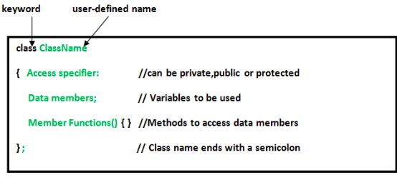
A Class is a user defined data-type which has data members and member functions.
Data members are the data variables
member functions are the functions used to manipulate these variables

Slide 3
Declaring Objects: To use the data and access functions defined in the class, you need to create objects.
Accessing data members and member functions: The data members and member functions of class can be accessed using the dot(‘.’) operator with the object.
Accessing Data Members
The public data members are also accessed in the same way given however the private data members are not allowed to be accessed directly by the object.

Slide 4
There are 2 ways to define a member function:
Inside class definition
Outside class definition
To define a member function outside the class definition we have to use the scope resolution :: operator along with class name and function name.

Slide 5
C++ CONSTRUCTOR

Slide 6
WHAT IS CONSTRUCTOR
A constructor in C++ is a special method that is automatically called when an object of a class is created.
It is a member function which initializes a class.
A constructor has:
(i) the same name as the class itself
(ii) no return type
A constructor is called automatically whenever a new instance of a class is created.
To create a constructor, use the same name as the class, followed by parentheses ():

Slide 7
CONSTRUCTOR TYPES
Default Constructors: Default constructor is the constructor which doesn’t take any argument. It has no parameters.
Parameterized Constructors: It is possible to pass arguments to constructors. Typically, these arguments help initialize an object when it is created. To create a parameterized constructor, simply add parameters to it the way you would to any other function. When you define the constructor’s body, use the parameters to initialize the object.
Copy Constructor: A copy constructor is a member function which initializes an object using another object of the same class
.

Slide 8
Default Constructor
#include <iostream>
using namespace std;
class mca { // The class
public: // Access specifier
mca() { // Constructor
cout << "Hello World!";
}
};
int main() {
mca myObj; // Create an object of MyClass (this will call the constructor)
return 0;
}

Slide 9
Constructor Parameters
Constructors can also take parameters (just like regular functions), which can be useful for setting initial values for attributes.

Slide 10
#include <iostream>
using namespace std;
class mca {
public:
mca(string x)
{
cout<<x;
}
};
int main() {
mca obj1("yasir");
mca obj2("iqbal ");
}

Slide 11
COPY CONSTRUTOR
A copy constructor is a member function that initializes an object using another object of the same class
A Copy Constructor creates a new object, which is exact copy of the existing object. The compiler provides a default Copy Constructor to all the classes. Syntax:
class-name (class-name &){}

Slide 12
#include <iostream>
using namespace std;
class lpu
{ public:
int x;
lpu (int a) // this is parameterized constructor
{ x=a;
cout<<"value of x in contructor "<<x; }
lpu (lpu &i) // this is copy constructor
{ x = i.x;
cout<<"\nvalue of x in copy constructor"<<i.x; }
};
int main ()
{ lpu a1(40); // Calling the parameterized constructor.
lpu a2=a1; // Calling the copy constructor.
}

Slide 13
When is a user-defined copy constructor needed? If we don’t define our own copy constructor, the C++ compiler creates a default copy constructor for each class
The compiler created copy constructor works fine in general.
We need to define our own copy constructor only if an object has pointers or any runtime allocation of the resource like filehandle, a network connection..etc.

Slide 14
DESTRUCTOR
A destructor works opposite to constructor
It destructs the objects of classes.
It can be defined only once in a class.
Like constructors, it is invoked automatically.
A destructor is defined like constructor. It must have same name as class. But it is prefixed with a tilde sign (~).
syntax
~classname()
{
}

